Slide 1

Phase Field Modelling of Solidification Process
By Sanas Varad Ravindra
(SC19B032)
Dept. of Aerospace Engg.
IIST.
Guided by
Dr. Chakravarthy P.
Dr. B. S. Girish

Slide 2
Introduction

Slide 3

Phase Field Modelling
The physical and mechanical properties of material depends on microstructure.
Phase-field modelling is a powerful tool for modelling microstructure evolution with time.
The temporal evolution of microstructure is expressed in terms of set of differential equations in time and spatial coordinates.
These equations are solved using mathematical methods.

Slide 4
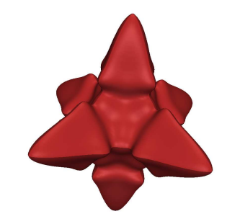
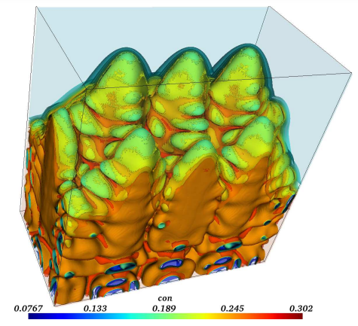
Phase Field Modelling
It has applications in simulating interfacial problems such as
  Solidification
Phase Field Simulation of Al-Mg dendrite [2]

Slide 5
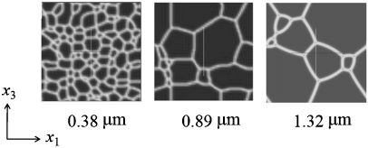
Phase Field Modelling
  Grain growth

Slide 6
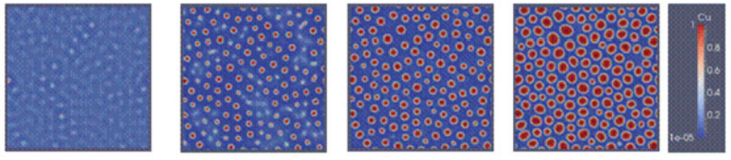
Phase Field Modelling
  Precipitate growth
Precipitation of Cu in Fe-Cu-Mn-Ni alloy at 823 K.

Slide 7
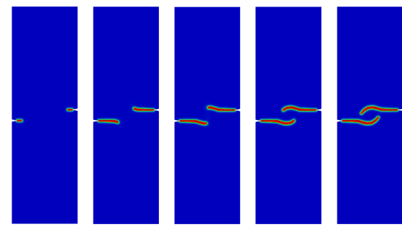
Phase Field Modelling
  Crack propagation
Phase field simulation of fatigue crack propagation

Slide 8
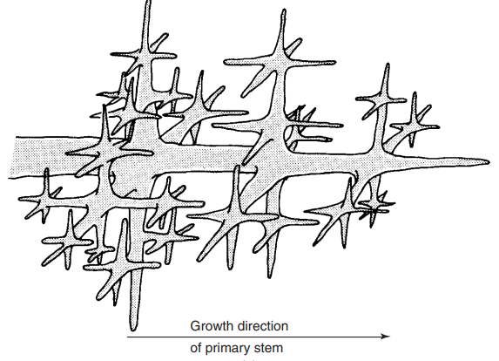
Dendrite Formation
The dendrite growth is a common phenomenon in metals and alloys.
The dendrite are formed during the solidification.
The study of dendrites, their size, shape and growth velocity is very important.

Slide 9
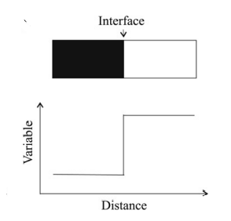
Historical Background
Before phase field modelling Solidification simulation was based on work of Stephan (1899) known as Sharp Interface Model.
In sharp interface model interface between different phases is considered to be infinitely sharp.
Governing equations consists diffusion equations which need to be solved for each phase.
Along with that two moving boundary conditions also needs to be applied at the solid liquid interface.
  Flux Conservation
  Gibb’s Thompson condition

Slide 10
Historical Background
Sharp interface model is a free boundary problem.
In this model a constant tracking of interface is required for applying boundary conditions.
The numerical simulation of this model is difficult.
On the other hand, there is no need to track the interface in phase field modelling.

Slide 11
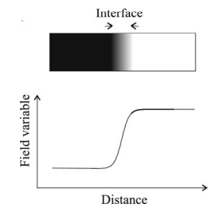
Phase Field Modelling
In phase field method an interface is assumed to be of finite thickness.
Microstructure is expressed in terms of field variables.
Field variables are continuous functions of space and time.
In the bulk phase, field variables take same constant value as in sharp interface model.
But at the interface, its value changes smoothly and continuously.

Slide 12
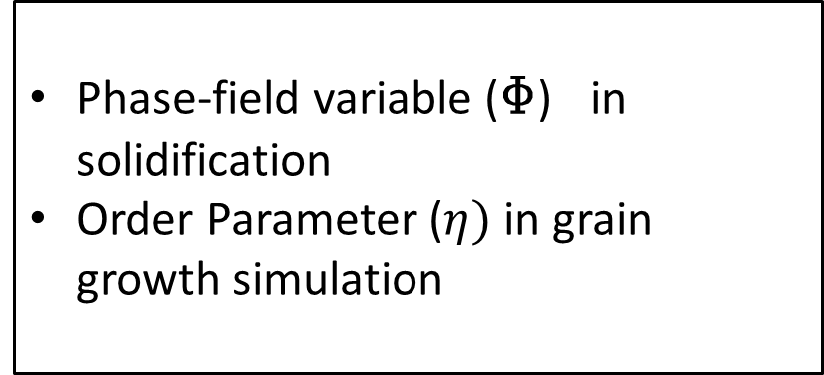
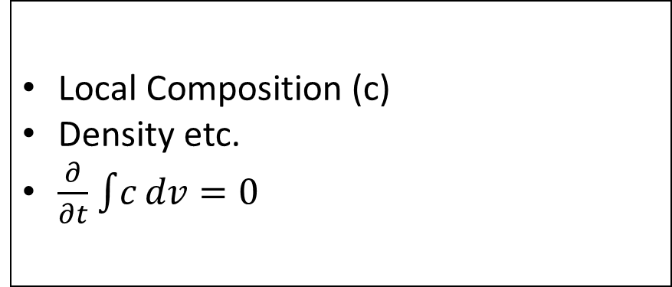
Phase Field Modelling
Phase Field Variables
Conserved Variables
Non- Conserved Variables
Local Composition (c)
Density etc.
$\frac{∂}{∂t}$ $\int{c}dv=0$
Phase-field variable (Φ) in solidification
Order Parameter ($η)$ in grain growth simulation

Slide 13
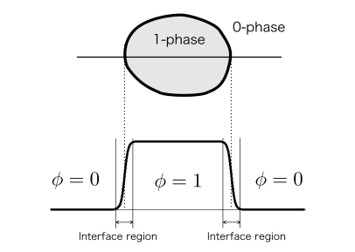
Phase Field Variable (Φ)
It is a Non conserved variable.
In the case of modelling solidification process we need one phase field variable Φ.
Φ tells phase of the system at a particular point in the domain at particular a time.
Φ= 0 in the liquid phase and Φ= 1 in solid phase.
At the interface value will change continuously from 0 to 1.
Phase field representation

Slide 14
Methodology
Defining the required phase field variables
Deriving PDEs representing temporal and spatial evolution of phase field variables
Solving PDEs using numerical methods
Visualization of results

Slide 15
Literature Review

Slide 16
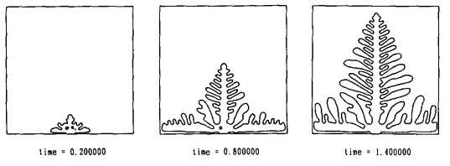
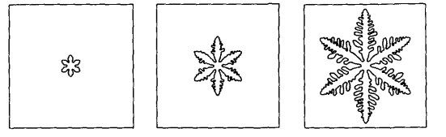
Kobayashi Model (1993)
Kobayashi was the first to model dendritic solidification successfully.
This model was good enough to study the effect of undercooling , latent heat on dendrite growth.
The solution of model is not very accurate .
This model doesn’t show realistic representation of dendrite. e.g. Ternary branching can not be seen in the simulation.

Slide 17
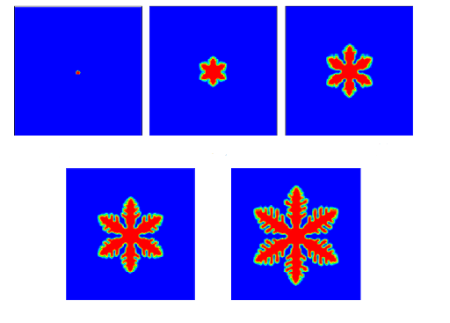

Kobayashi Model (1993)
Abdullah et. al. Numerical Simulation of Two-Dimensional Dendritic Growth Using Phase-Field Model
Ferreira et.al. Simulation of the solidification of pure nickel via the phase-field method.

Slide 18
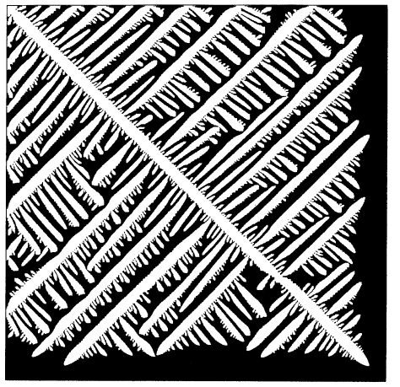
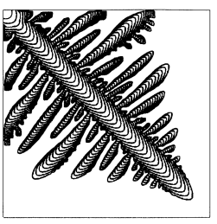
Kim Model (1999)

Slide 19
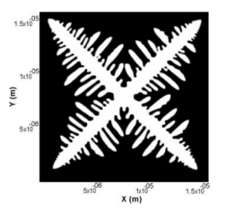
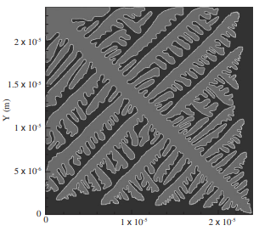
Kim Model (1999)

Slide 20
Literature Review
First phase field model for alloys was developed Wheeler called as WBM model.
Later Warren (1996) and Beckerman (1999) proposed phase field models for binary alloy solidification
Loginova et al. (2001) presented phase field model for non isothermal alloy solidification.
Karma (2001) and Kim (2007) introduced idea of anti trapping current in phase field modelling to include effect of unequal thermal conductivities, interface stretching, interface diffusion etc.

Slide 21
Research Gap
Most of phase field models are developed for the single component and binary alloy systems only. Less models are available for the simulation of ternary and multicomponent alloys.
Most people have done the simulation for general alloys such as Cu-Ni and Al-Mg.
The run time for the programs generated for the simulations are seen to be very high.

Slide 22
Objectives
To Study the basics of phase field modelling
Simulation of phase field models for pure melt
Kobayashi Model
Kim Model
Simulation of phase field model for binary alloy
Phase field model for the ternary alloy especially an aerospace alloy.
Use of CALPHAD database

Slide 23
Model Formulation

Slide 24

Free energy functional
The driving force for microstructural evolution is the reduction in the free energy of the system.
The free energy F is expressed as :
In Phase field method the free energy F is expressed as a functional of the set of phase-field variables and their gradients.
In governing equations for phase field modelling are derived from free energy functional.

Slide 25

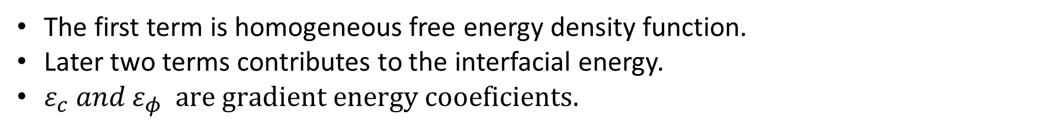
Free energy functional
In the case of solidification of the binary alloy free energy functional is given as
[2]
The first term is homogeneous free energy density function.
Later two terms contributes to the interfacial energy.
$ε_{c} and ε_{φ} are gradient energy cooeficients.$

Slide 26
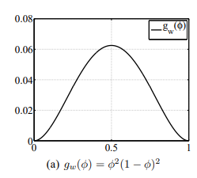
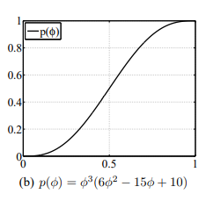
Free energy functional
Homogeneous free energy density function $f(φ,c,T)$
Single component system containing pure element A
[3]
Double well function
Adds energy barrier between two phases.
Interpolating function

Slide 27

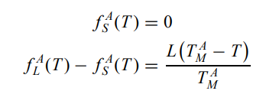

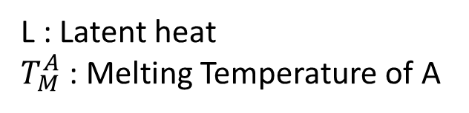
Free energy functional
Homogeneous free energy density function $f(φ,c,T)$
Single component system containing pure element A
[3]
L : Latent heat
$T_{M}^{A}$ : Melting Temperature of A

Slide 28

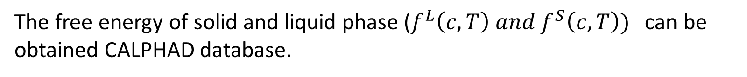
Free energy functional
Homogeneous free energy density function $f(φ,c,T)$
Binary alloy system
[2]
CALPHAD (CALculation of PHAse Diagrams) Method
[2]
The free energy of solid and liquid phase ($f^{L}\left(c,T\right) and f^{S}\left(c,T\right))$can be obtained CALPHAD database.

Slide 29
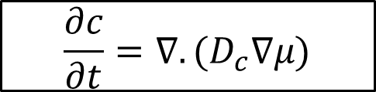
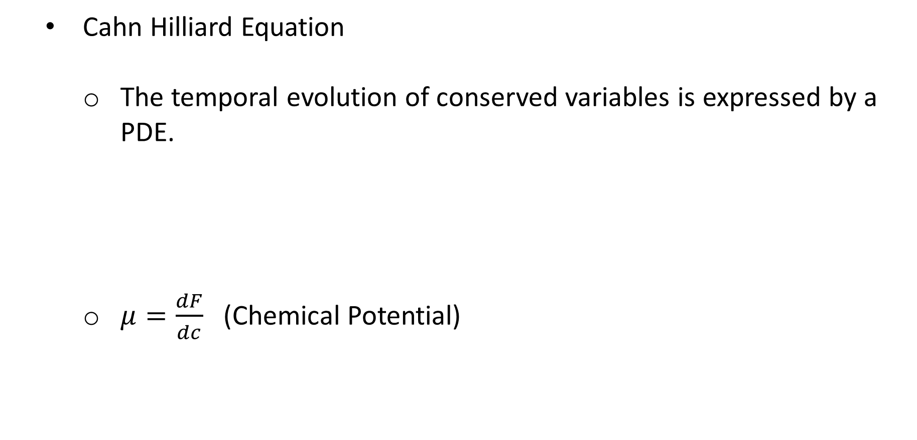
Governing Equations
  Cahn Hilliard Equation
    The temporal evolution of conserved variables is expressed by a PDE.
    $μ=\frac{dF}{dc}$ (Chemical Potential)
$$\frac{∂c}{∂t}=∇.(D_{c}∇μ)$$
[4]

Slide 30

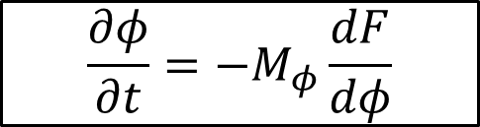
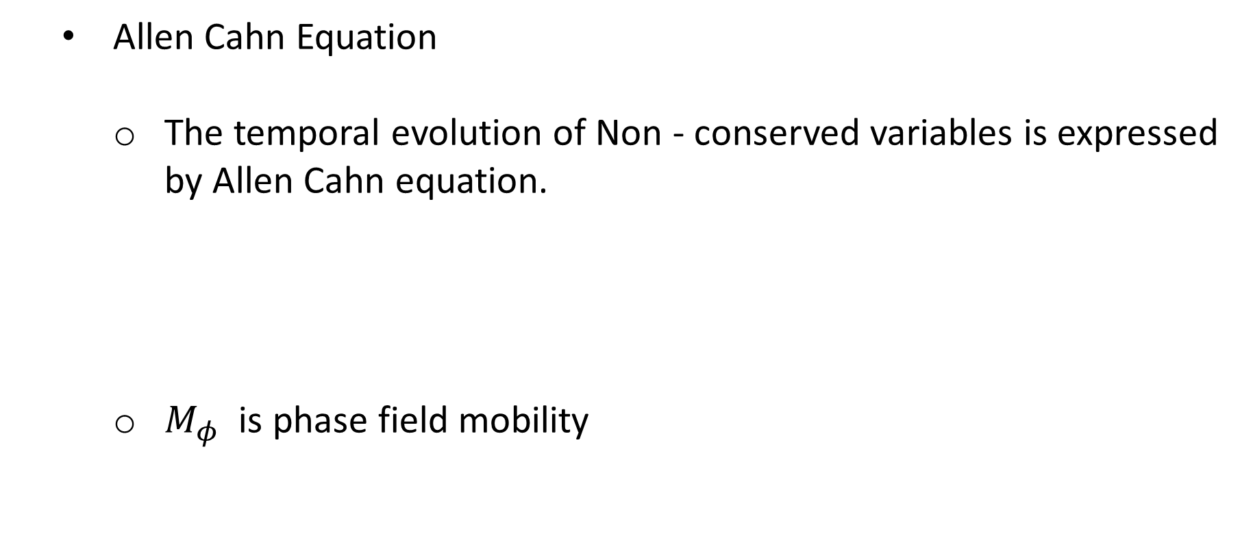
Governing Equations
  Allen Cahn Equation
    The temporal evolution of Non - conserved variables is expressed by Allen Cahn equation.
    $M_{φ}$ is phase field mobility
$$\frac{∂φ}{∂t}=−M_{φ}\frac{dF}{dφ}$$
[4]

Slide 31
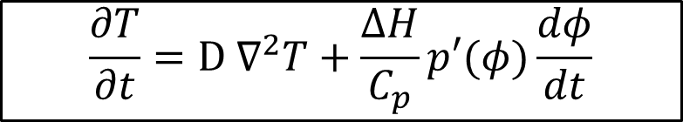
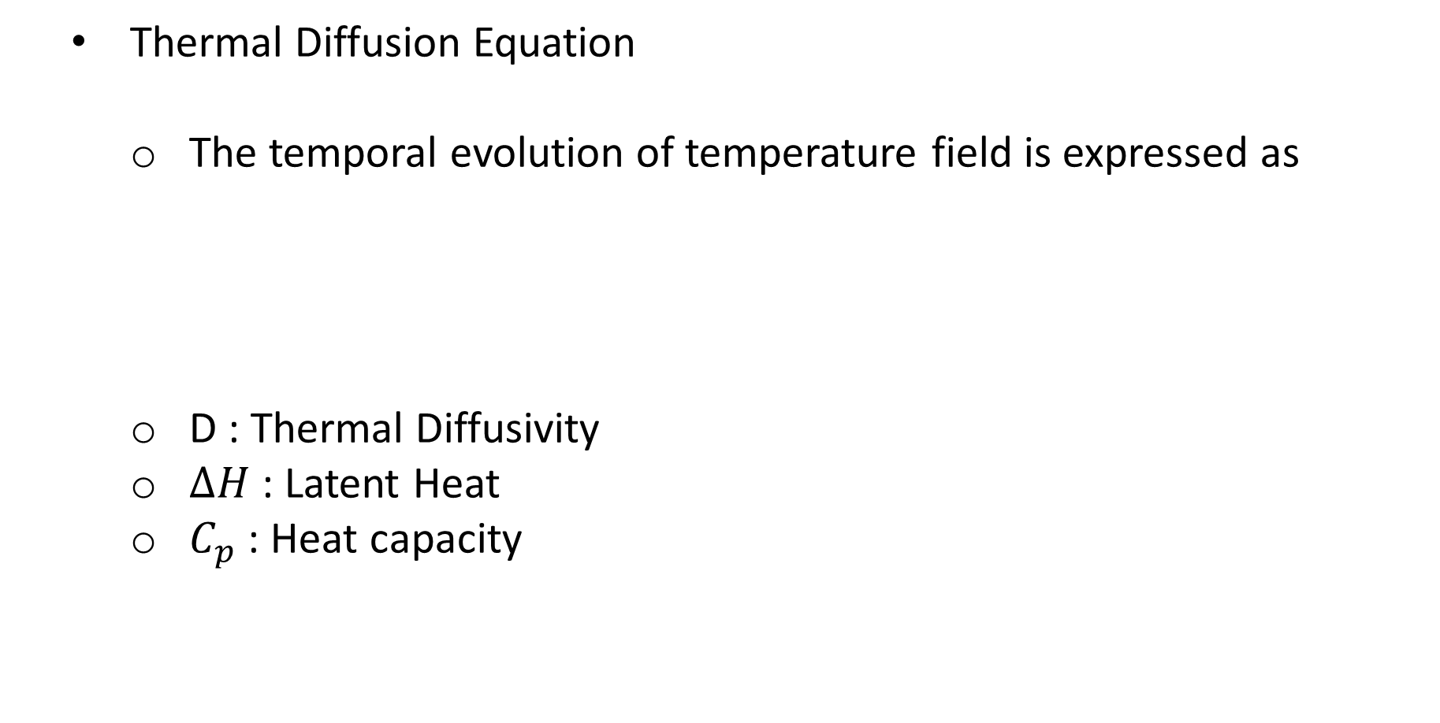
Governing Equations
  Thermal Diffusion Equation
    The temporal evolution of temperature field is expressed as
    D : Thermal Diffusivity
    $ΔH$ : Latent Heat
    $C_{p}$ : Heat capacity
$$\frac{∂T}{∂t}=D ∇^{2}T+\frac{ΔH}{C_{p}}p′(φ)\frac{dφ}{dt}$$
[4]

Slide 32
Numerical Implementation

Slide 33
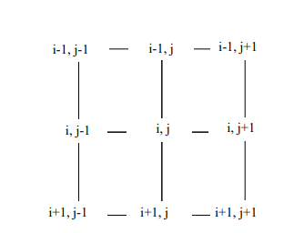

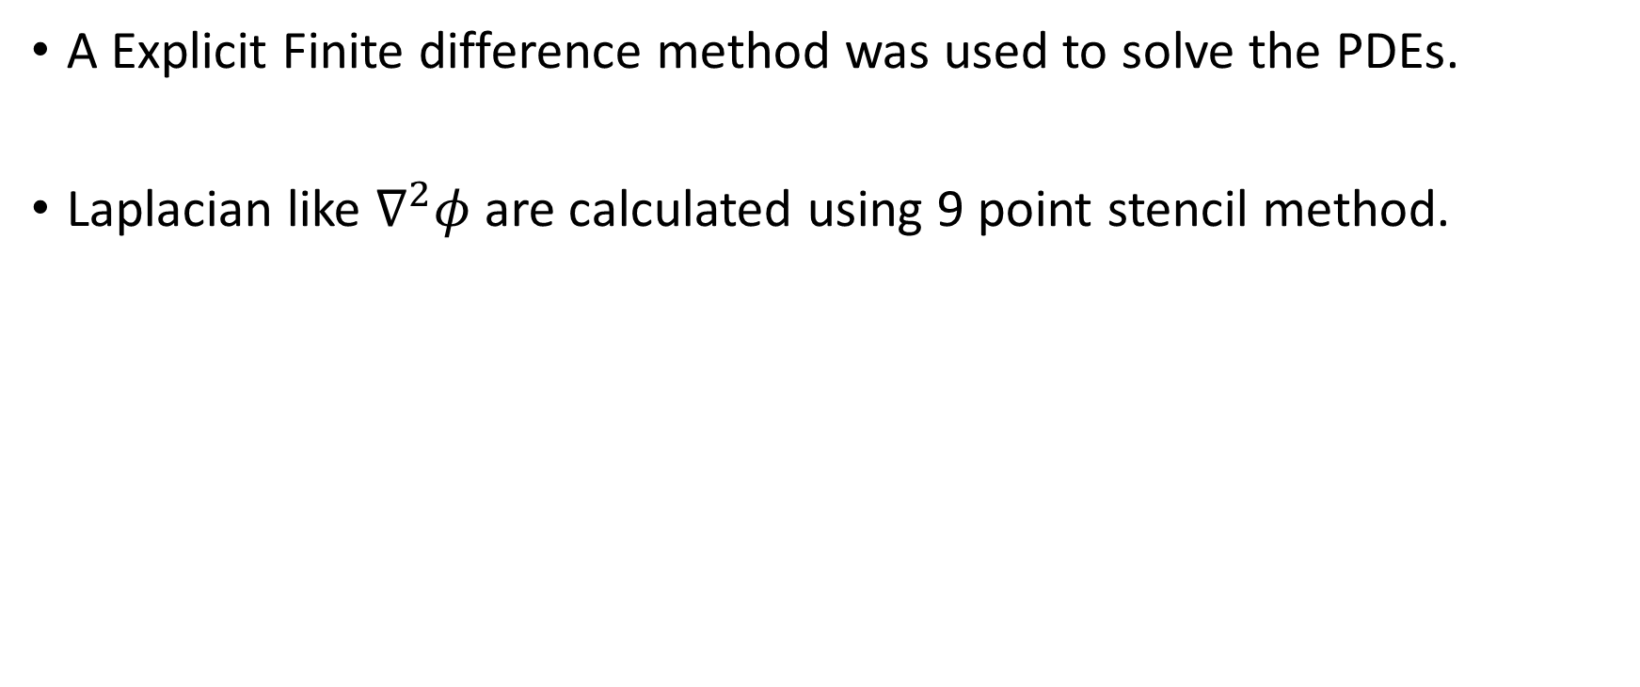
Numerical Implantation
A Explicit Finite difference method was used to solve the PDEs.
Laplacian like $∇^{2}φ$ are calculated using 9 point stencil method.
[2]

Slide 34
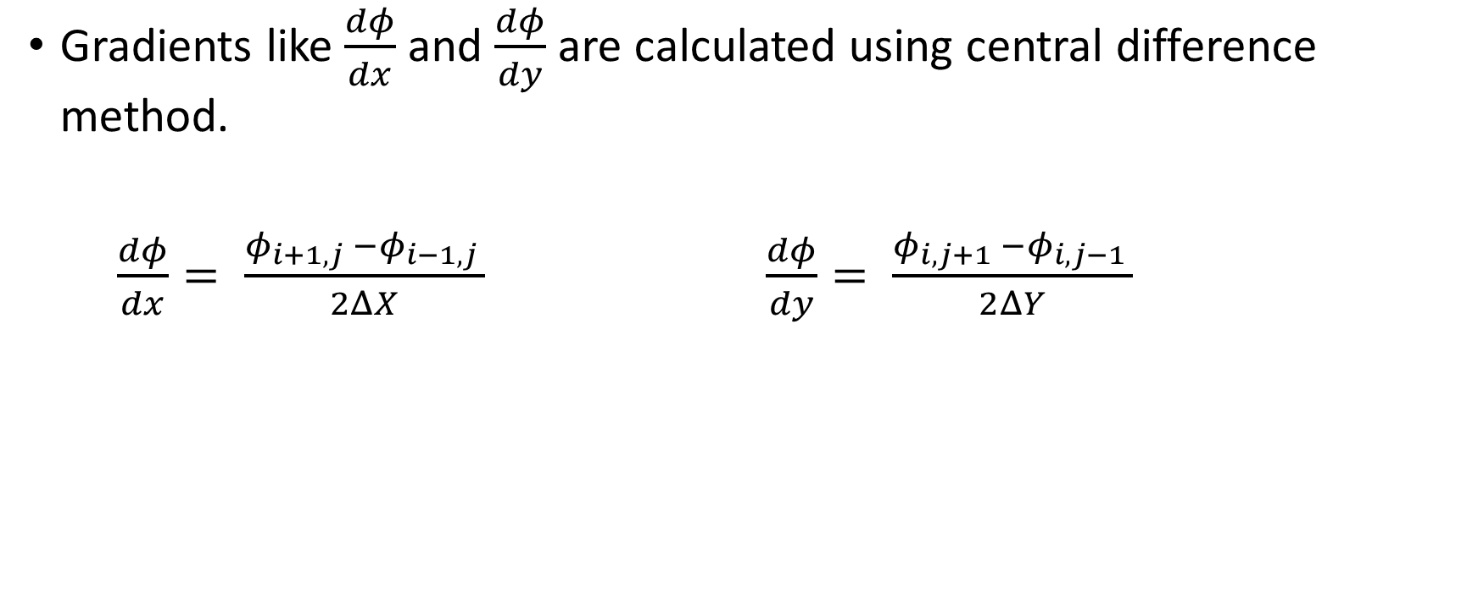
Numerical Implantation
Gradients like $\frac{dφ}{dx}$ and $\frac{dφ}{dy}$ are calculated using central difference method.
$\frac{dφ}{dx}= \frac{φ_{i+1,j }−φ_{i−1,j }}{2ΔX}$ $\frac{dφ}{dy}= \frac{φ_{i,j+1 }−φ_{i,j−1 }}{2ΔY}$

Slide 35
Results

Slide 36

Verification of Kobayashi Model(1993)
Kobayashi presented phase field model for solidification of pure melt .
The model verification is done here.
According to Kobayashi model free energy functional is given as:
[5]

Slide 37


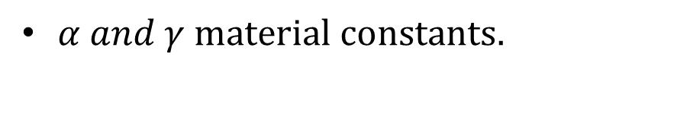
Verification of Kobayashi Model(1993)
Homogeneous free energy density function given as
[5]
(m) is parameter which depends on temperature.
[5]
$α and γ material constants.$

Slide 38


Verification of Kobayashi Model(1993)
Time evolution of phase field parameter is given by
The Non dimensional thermal diffusion equation is given as
K is non dimensional constant represents latent heat
T=1 at melting point and T=0 at initial undercooled temperature.

Slide 39
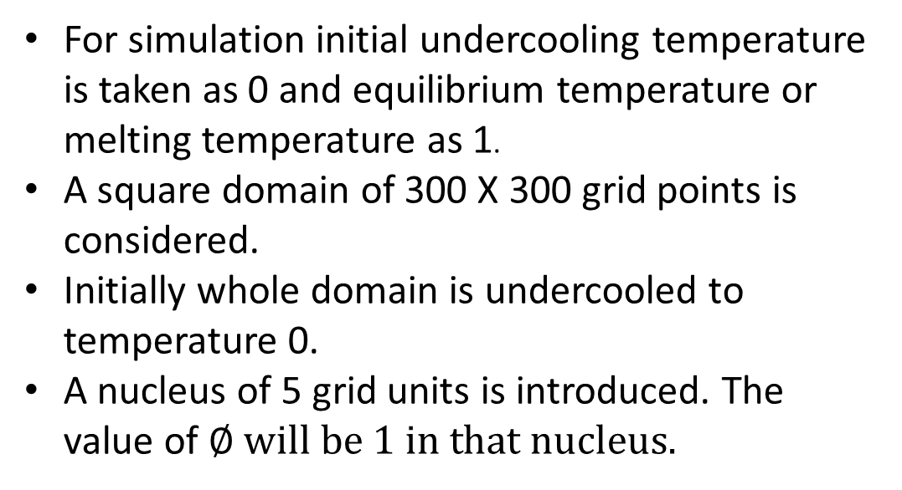
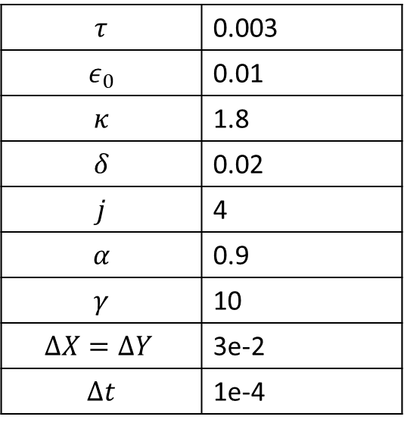
Verification of Kobayashi Model(1993)
Non dimensional parameters
$$τ$$ | 0.003
$$ε_{0}$$ | 0.01
$$κ$$ | 1.8
$$δ$$ | 0.02
$$j$$ | 4
$$α$$ | 0.9
$$γ$$ | 10
$$ΔX=ΔY$$ | 3e-2
$$Δt$$ | 1e-4
For simulation initial undercooling temperature is taken as 0 and equilibrium temperature or melting temperature as 1.
A square domain of 300 X 300 grid points is considered.
Initially whole domain is undercooled to temperature 0.
A nucleus of 5 grid units is introduced. The value of $∅ will be 1 in that nucleus.$

Slide 40
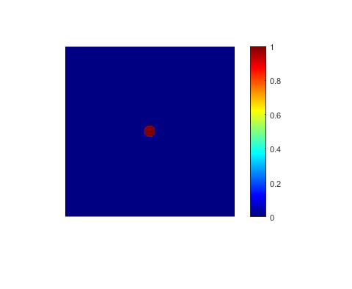
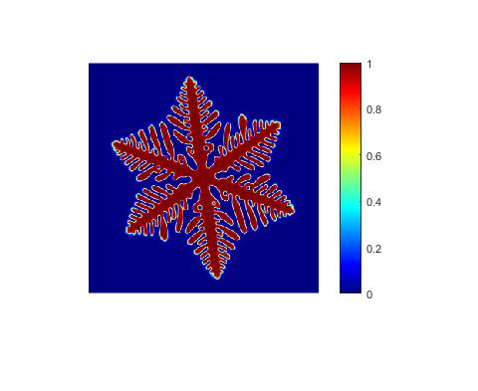
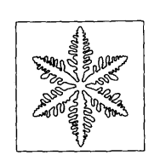
Simulation Results
Kobayashi (1993)

Slide 41

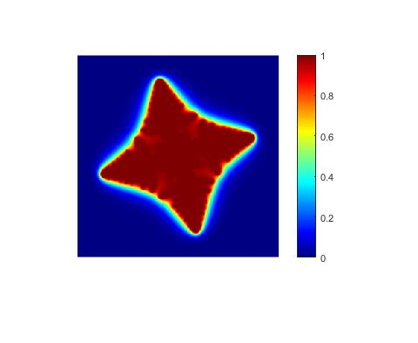
Simulation Results

Slide 42
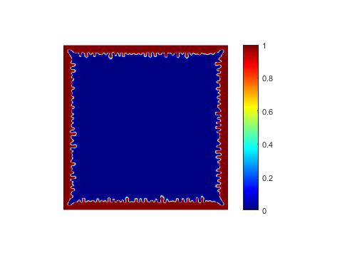
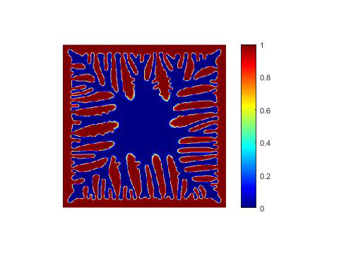
Simulation Results

Slide 43
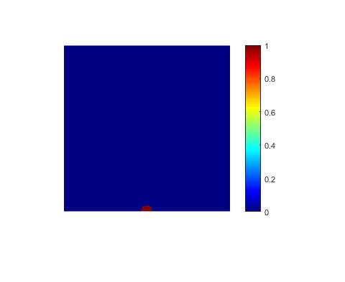
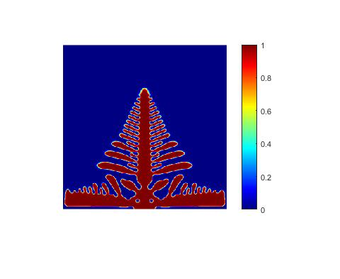
Simulation Results

Slide 44
Further Work
Phase field simulation of Binary Alloy.
To learn to use CALPHAD database in phase field modelling.
Phase field simulation of Ternary alloy using CALPHAD database.
Verification of results on MICRESS software.

Slide 45
References
Nele Moelans , Bart Blanpain, Patrick Wollants ,An introduction to phase-field modeling of microstructure evolution.
P. Gerald , Phase-field Modelling of Microstructure Evolution During Solidification Incorporating CALPHAD Description of Gibbs Energies
W. J. Boettinger, J. A. Warren, C. Beckermann, and A. Karma, “Phase-Field Simulation of Solidification,” Annu. Rev. Mater. Res., vol. 32, pp. 163–194, 2002.
Alexandre Furtado Ferreira ,Leonardo de Olivé Ferreira, Abner da Costa Assis, Numerical simulation of the solidification of pure melt by a phase-field model using an adaptive computation domain.
Kobayashi, R. (1992). Simulations of three dimensional dendrites. Pattern Formation in Complex Dissipative Systems, 121–128
Seong Gyoon Kim, Large Melt Scale Simulation of by Phase-field Model Dendritic Growth in Pure Undercooled Melt.

Slide 46
References
Abdullah Shah, Ali Haider, Said Karim Shah, Numerical Simulation of Two-Dimensional Dendritic Growth Using Phase-Field Model
Ferreira, Alexandre & da Silva, Alexandre & De Castro, Jose. (2006). Simulation of the solidification of pure nickel via the phase-field method.

